Slide 1
Research Progress
Aug 9, 2018
Xingyu Su

Slide 2
Overview
Test with Steven for Length Detector
Serial Debug (Fixed with Fu Hai and Steven)
Memory Leaks (Fixed)
Learn PowerShell and write scripts
Search for choosing C++ NN platform
Learn TensorFlow and CNN
Try particle tracking

Slide 3
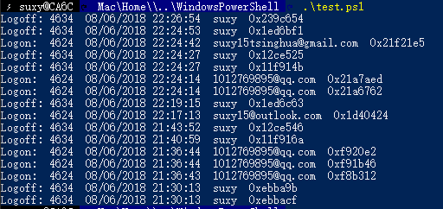
Log on & off Scripts
The Lab needs to monitor who used the microscope computer.
After searching and learning, I used PowerShell to read and analyze Windows Event Log and save to CSV.

Slide 4
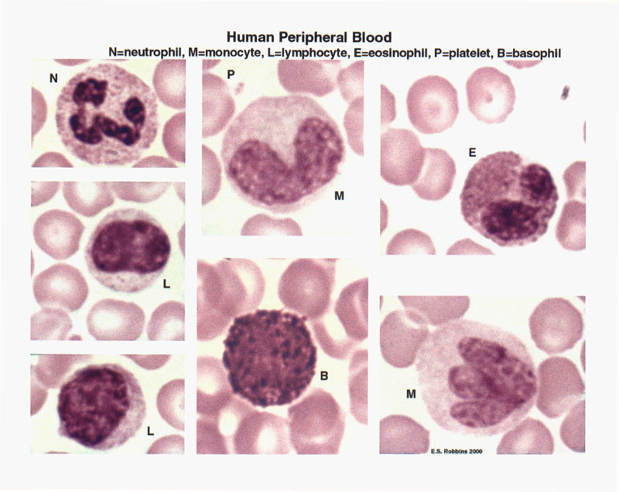
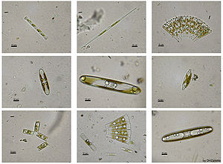
Machine Learning Cell Detection
Detect cell by image processing and machine learning
Send triggers to manipulate
Better recognition but lower throughput
Phytoplankton
Blood cell

Slide 5
Machine Learning Cell Detection
Try to find a best way to implement Neural Network
Theano
mlpack
tiny-dnn
OpenNN
Caffe
TensorFlow
Build NN and save parameters on *unix by Python
Load parameters and predict on windows C++
Install and learn TensorFlow
MLP on mnist: 91.3% accuracy
CNN on mnist: 99.2% accuracy
Compute on Google Colab (Using GPU for free, 20x faster than CPU)

Slide 6
iOS Particle Tracking
C++ Demo (only detection, with no tracking now)
Basic thoughts:
detecting points -> history neighbor searching -> label matching -> trajectory

Slide 7
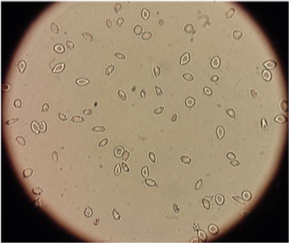
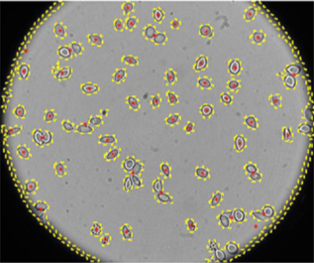
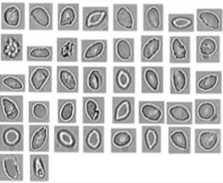
Next Week Plan
Parse training data from Steven’s video
Test with Geonsoo’s channel
Learning and implementing tracking algorithm
For droplets
For particles

Slide 8
Thanks
Notes:
Thanks all of you for watching and listening.

